Slide 1

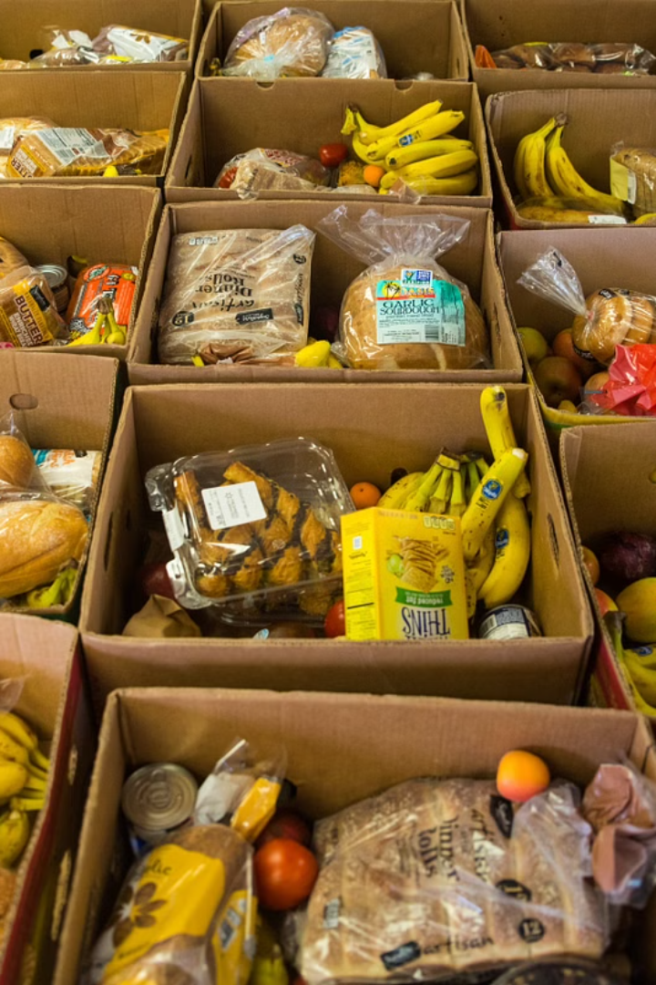
Food Waste Reduction and Redistribution Platform
GitHub: - SOEN-6841_Group-29 Project (github.com)
Group 29:
Dhruvil Anilbhai Patel: 40226179
Jayati Anilkumar Thakkar : 40230506
Dhruvil Dineshbhai Patel: 40220130
Vijendra Nannulal Ahirwal : 40221273
Nisarg Hitesh Adalja: 40276285

Slide 2
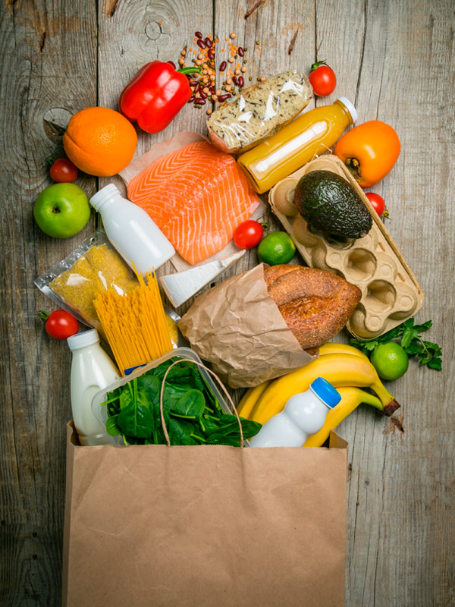
Imagine a world where surplus food brings smiles rather than waste – That's the world we're building with our innovative software solution. By connecting food establishments like restaurants and grocery stores with community organizations, we're transforming the way we manage and redistribute excess food, creating a more sustainable and equitable food system.

Slide 3

The Problem: Inefficient Food Waste Management
Despite the abundance of food produced globally, a staggering amount of it ends up in landfills, contributing to environmental degradation, economic losses, and missed opportunities to feed those in need. Restaurants, grocery stores, and other food establishments often struggle to effectively manage their surplus inventory, leading to significant food waste. This inefficiency not only harms the planet but also deprives community organizations and individuals of access to nutritious, wholesome food.
1
Environmental Impact
Food waste in landfills releases methane, a potent greenhouse gas, contributing to climate change. Reducing food waste can have a significant positive impact on the environment.
2
Economic Implications
Billions of dollars are lost annually due to the waste of edible food, a cost that is ultimately passed on to consumers. Effective food waste management can lead to substantial cost savings.
3
Social Consequences
While millions of people struggle with food insecurity, valuable food resources are being discarded. Bridging this gap can address issues of hunger and improve access to nutritious meals.

Slide 4
The Solution: A Food Waste Reduction and Redistribution Platform
Our innovative software platform leverages the power of AI to predict and manage surplus food, enabling seamless coordination between food establishments and community organizations. By providing real-time alerts, streamlining pickups and deliveries, and tracking the impact of redistributed food, we're creating a more efficient and sustainable food system.
Real-Time Alerts
Coordinated Pickups and Deliveries
Impact Tracking
Our advanced algorithms analyze data from food establishments to accurately predict and alert them to upcoming surplus. This allows for timely coordination with community organizations, ensuring food is redistributed before it goes to waste.
Our platform seamlessly orchestrates the logistics of food pickups and deliveries, connecting food establishments with community organizations in need. This streamlined process reduces the administrative burden and ensures that surplus food reaches those who need it most.
By monitoring the distribution and utilization of redistributed food, our platform provides valuable insights into the environmental, economic, and social impact of our efforts. This data-driven approach allows us to continuously refine and improve our solutions.

Slide 5
Market Justification: Addressing a Growing Need
The need for a comprehensive food waste reduction and redistribution platform is evident. According to a recent study, approximately 40% of all food produced in the United States goes to waste, with a significant portion coming from commercial establishments. This waste not only represents a tremendous loss of resources but also underscores the potential for a solution that can effectively connect surplus food with those in need.
1
Market Analysis
Our market research has identified a growing demand for innovative solutions that can address the challenges of food waste. Community organizations and food banks have expressed a strong interest in partnering with platforms that can facilitate the redistribution of surplus food, highlighting the potential for our solution to succeed in the market.
2
Potential for Impact
By effectively connecting food establishments with community organizations, our platform has the potential to significantly reduce food waste and increase food security in the communities we serve. Data from pilot programs in similar initiatives has shown that such platforms can divert thousands of pounds of food from landfills and provide meals to those in need.
3
Competitive Advantage
Our platform's unique combination of AI-powered predictive analytics, streamlined logistics, and comprehensive impact tracking sets us apart from existing solutions in the market. This innovative approach, coupled with our strategic partnerships and domain expertise, positions us for long-term success in the food waste reduction and redistribution space.

Slide 6
Feasibility and Viability: Transforming the Landscape
Our food waste reduction and redistribution platform is not only a conceptual idea, but a technologically feasible and economically viable solution that can be seamlessly integrated into existing workflows. By leveraging advanced AI algorithms, robust data integration, and user-friendly interfaces, we've designed a platform that can effectively address the challenges of food waste while delivering tangible benefits to all stakeholders.
Technical Feasibility
Economic Viability
Operational Feasibility
Our platform's AI-powered predictive analytics and data integration capabilities are built on a solid foundation of cutting-edge technology. Our team of experts has carefully designed the system architecture to ensure seamless data flow, real-time alerts, and user-friendly interfaces, making it easy for food establishments and community organizations to adopt and utilize the platform.
Our comprehensive cost analysis and financial projections demonstrate the economic viability of our platform. By reducing food waste and the associated costs, as well as generating revenue streams through partnerships and sponsorships, we've developed a sustainable business model that can deliver a strong return on investment for our stakeholders. Additionally, we're exploring various funding opportunities to support the platform's development and deployment.
Integrating our platform into the existing workflows of food establishments and community organizations is a key focus of our development process. We've collaborated extensively with industry partners to ensure seamless integration, minimizing disruption and maximizing the efficiency of food redistribution efforts. Our platform's user-friendly design and comprehensive training resources further enhance its operational feasibility.

Slide 7
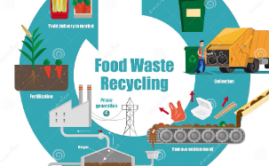
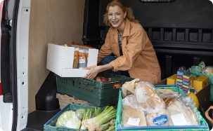
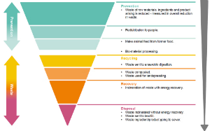
Highlights of the Solution
Our food waste reduction and redistribution platform is more than just a theoretical concept – it's a tangible, innovative solution that brings together technology, logistics, and strategic partnerships to create a transformative impact. With advanced visualizations and a sneak peek of the platform in action, we'll showcase the key features and benefits that make our solution a game-changer in the food waste management landscape.
Seamless Connections
Intuitive User Experience
Quantifiable Impact
At the heart of our platform is a robust system that seamlessly connects food establishments with community organizations, enabling the efficient redistribution of surplus food. Our user-friendly interface and real-time alerts ensure that food is matched with those in need, reducing waste and maximizing impact.
We've designed our platform with the user in mind, creating an intuitive and streamlined interface that makes it easy for food establishments and community organizations to manage their surplus and distribution efforts. From scheduling pickups to tracking impact, our platform simplifies the process, saving time and resources.
Our platform's comprehensive data tracking and analysis capabilities provide valuable insights into the environmental, economic, and social impact of our food redistribution efforts. By monitoring key metrics, we can continuously refine our strategies, showcase our achievements, and drive meaningful change in the fight against food waste.

Slide 8
Project Plan: A Phased Approach
Bringing our food waste reduction and redistribution platform to life requires a well-planned and executed project roadmap. We've carefully crafted a phased approach that ensures the successful development, deployment, and ongoing optimization of our solution, addressing key milestones and delivering tangible results at every stage.
1
Phase 1: System Design
In this initial phase, we'll focus on the comprehensive design of our platform, including the architecture, data integration, and user experience. Our team of experts will work closely with industry partners to ensure the solution aligns with the needs of food establishments and community organizations, setting the foundation for a successful implementation.
2
Phase 2: Platform Development
With the system design in place, we'll move into the development phase, where our skilled engineers will bring the platform to life. This stage involves the coding, testing, and refinement of the AI-powered algorithms, user interfaces, and logistics coordination features, ensuring a seamless and reliable user experience.
3
Phase 3: Pilot and Deployment
Before the full-scale rollout, we'll conduct a comprehensive pilot program to validate the platform's functionality, gather user feedback, and make any necessary adjustments. Once the pilot is successful, we'll deploy the platform to our initial set of food establishment and community organization partners, laying the groundwork for widespread adoption.

Slide 9



Risk Management: Navigating Challenges
As with any transformative project, our food waste reduction and redistribution platform faces potential challenges and risks that we've carefully identified and planned for. By proactively addressing these risks, we can ensure the long-term success and sustainability of our solution.
Algorithmic Complexity
The development of the AI-powered predictive analytics at the core of our platform requires a deep understanding of machine learning and data science. To mitigate this risk, we've assembled a talented team of experts who are well-versed in these advanced technologies, ensuring the algorithms are robust and reliable.
Data Integration Challenges
Seamlessly integrating data from various food establishments and community organizations is crucial for the platform's success. We've implemented a comprehensive data management strategy, including secure data protocols and user-friendly interfaces, to address any potential data integration hurdles.
Stakeholder Adoption
Ensuring widespread adoption of our platform by food establishments and community organizations is essential for achieving our goals. To address this risk, we've placed a strong emphasis on user-centric design, comprehensive training resources, and strategic partnerships to drive engagement and adoption.

Slide 10
Budget Overview: Investing in a Sustainable Future
Developing and deploying our food waste reduction and redistribution platform requires a well-structured budget that allocates resources effectively across various project areas. By carefully planning our expenditures and securing the necessary funding, we're confident in our ability to deliver a sustainable and impactful solution that transforms the way surplus food is managed.
Development
45%
Testing and Quality Assurance
15%
Marketing and Outreach
20%
Operations and Maintenance
20%
Our budget breakdown reflects the strategic importance we place on the platform's development, ensuring that our engineering team has the resources they need to create a robust and reliable solution. We've also dedicated a significant portion of the budget to marketing and outreach, as we recognize the critical role of awareness and partnership-building in driving the platform's adoption and impact.

Slide 11
Conclusion
Addressing a Critical Need: We've highlighted the pressing issue of food waste and how our innovative platform not only tackles this challenge but also fosters community engagement and sustainability.
Technological Innovation: Our platform leverages advanced AI to predict surplus food availability, ensuring efficient redistribution, minimizing waste, and supporting those in need.
Economic and Environmental Impact: By optimizing food redistribution, we contribute to significant economic savings for food establishments and substantial environmental benefits by reducing waste.
Call to Action:
Engagement Request: We invite all stakeholders, including food establishments, community organizations, and investors, to join us in this transformative journey. Your support and engagement are crucial for amplifying the impact of this initiative.
Collaboration Invitation: Let's collaborate to refine and enhance this platform, ensuring it meets the diverse needs of our communities and maximizes its effectiveness in reducing food waste.
Next Steps: We encourage your active participation, feedback, and support as we move forward with the development and deployment of this platform. Together, we can make a substantial difference in our fight against food waste, fostering a more sustainable and inclusive future.
"By uniting our efforts, we can transform surplus food from a challenge into an opportunity – benefiting our environment, our communities, and our economy. Let's innovate, collaborate, and act to make food waste reduction a reality."

